Slide 1


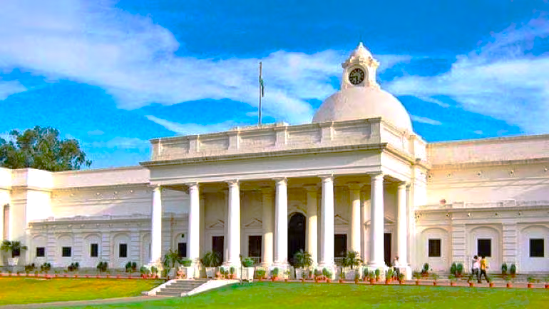

Handwritten Hindi Characters & Digits Recognition
PG Certificate Course in Data Science, AI/ML & Data Engineering By E&ICT Academy, IIT Roorkee (Cloudxlab)
Presented By : Amit Satnalika

Slide 2
Table of contents
01
Introduction & Background
02
Current Solution & Benchmark
Solution Architecture & Summary
03
04
Dataset Used
05
Performance Metrics
06
Improvement Plans
07
Future Scope
08
Appendix

Slide 3

Introduction & Background
Handwritten Hindi Characters & Digits Recognition (HCDR) remains largely unsolved despite advancements in object identification technology due to the presence of numerous confusing handwritten characters & digits and extremely cursive Hindi handwritings.
In India, we have many articles, nobles, poems, medical treatment, old research papers, property papers etc. are handwritten documents where some or entire text are handwritten that requires to be digitized or translated in other languages. Hence a accurate and robust solution is required.

Slide 4
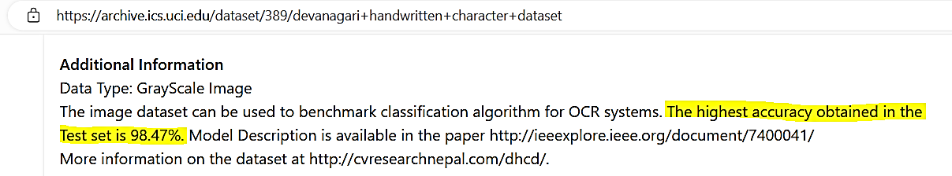

Current Solution & Benchmark
As per the UC Irvine Machine Learning
website from where dataset has been
used for this project, the highest
accuracy obtained so far in the Test set
is 98.47%.
An important point to note here, current solution obtained this much accuracy by predicting 46 different classes that consists (36 consonents & 10 digits) of 92K handwritten images & all these images are having same .png file format with black background.
However here in this project we have merged two different datsets that combiningly consists of 58 different classes (36 consonents , 10 digits & 12 vowels) of ~105K handwritten images & those are having two different (black & white) backgrounds with different extensions (.png & .jpeg), now lets see how much accuracy we have achieved.

Slide 5

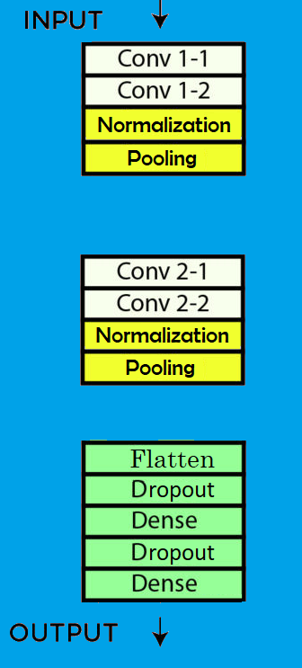
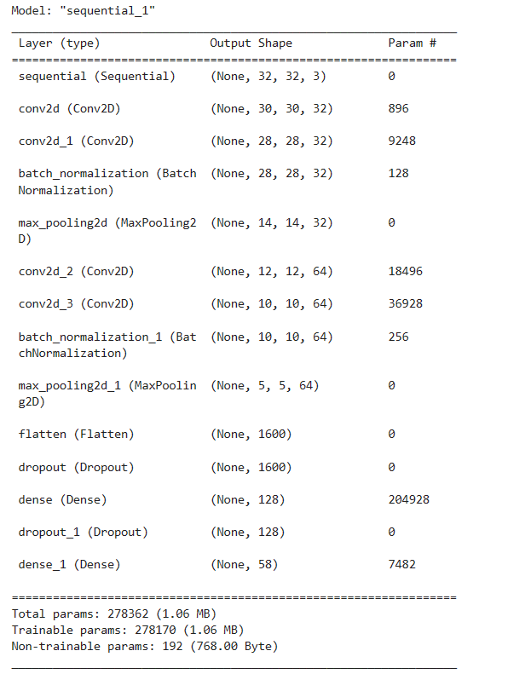
Solution Architecture & Summary
I : Using VGG Architecture

Slide 6

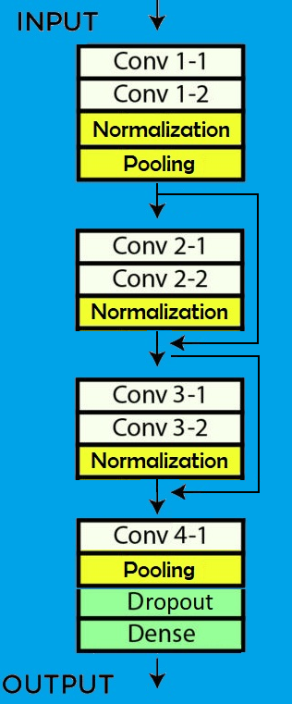
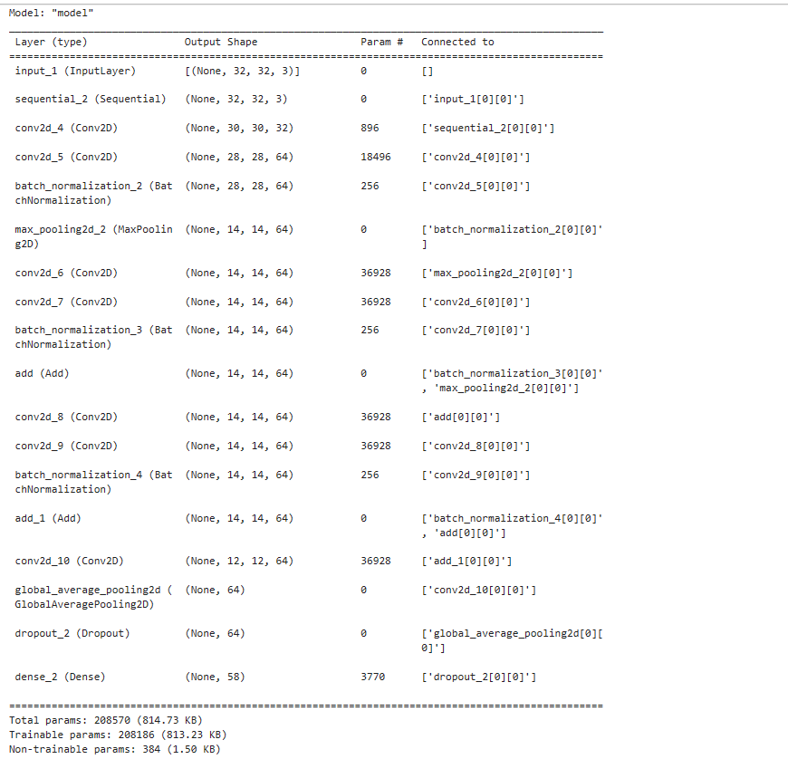
Solution Architecture & Summary
II : Using ResNet Architecture

Slide 7


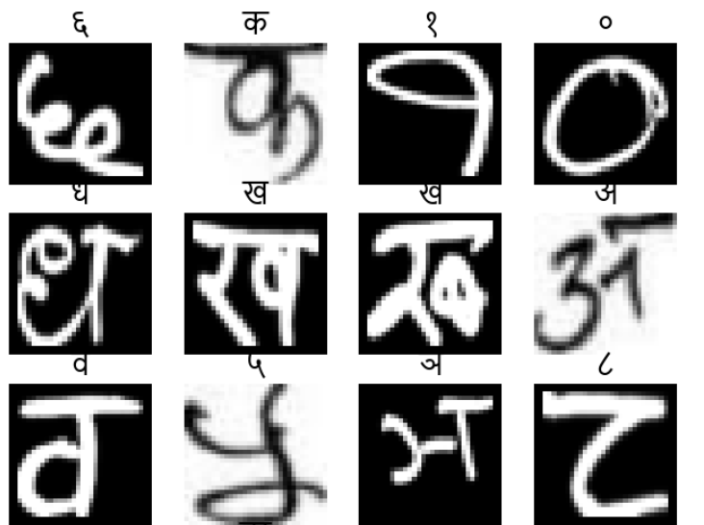
Dataset Used
UCI Devanagari Handwritten Character Dataset
Kaggle Devanagari Handwritten Character Dataset
This is an image database of Handwritten Devanagari characters. There are 46 classes of characters with 2000 examples each. The dataset is split into training set(85%) and testing set(15%). Image format is .png and resolution of the images are 32 by 32. Actual character is centred within 28 by 28 pixel, padding of 2 pixel is added on all four sides of actual character.
This dataset contains three individual categories. Samples are collected from 40 individuals (persons) from different fields and cropped for character boundary :
→ Numerals (288 samples per class, 10 classes)
→ Vowels (221 samples per class, 12 classes)
→ Consonants (205 samples per class, 36 classes)

Slide 8

Performance Metrics
98.26%
98.97%
VGG Approach
ResNet Approach
Accuracy on Test Data – 98.26 %
Total (Training + Validation) Data Size - 88526
Total Test Data Size – 16386
Total Correct Predictions - 16105
Total Incorrect Predictions– 281
Accuracy on Test Data – 98.97 %
Total (Training + Validation) Data Size - 88526
Total Test Data Size – 16386
Total Correct Predictions - 16217
Total Incorrect Predictions– 169

Slide 9

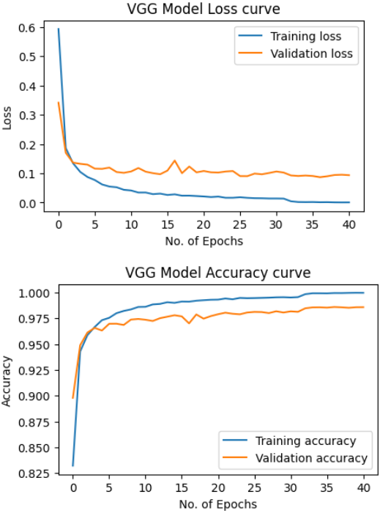
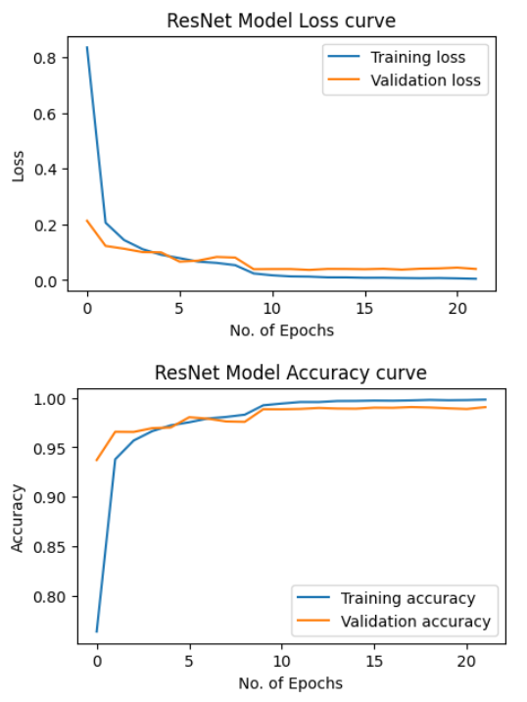
Performance Graphs

Slide 10


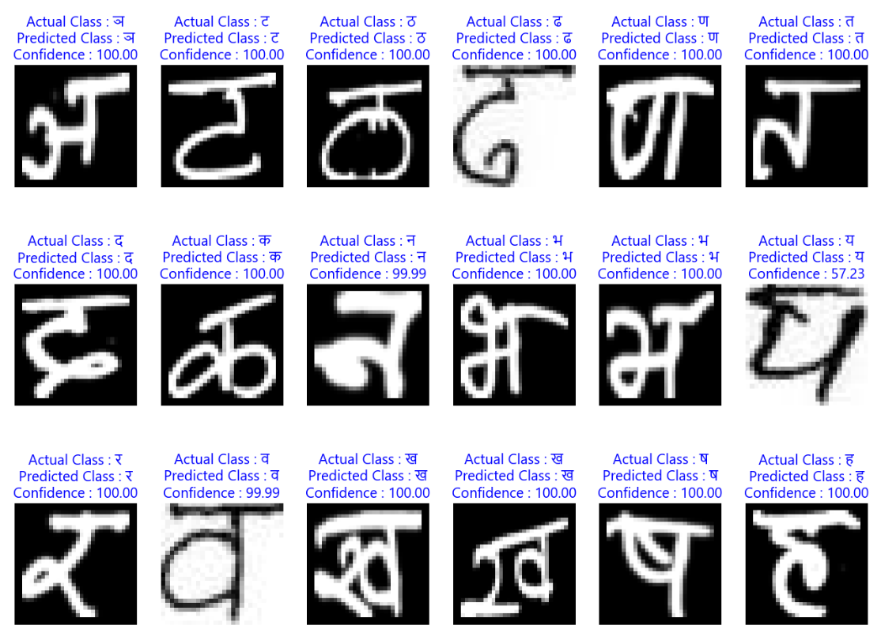
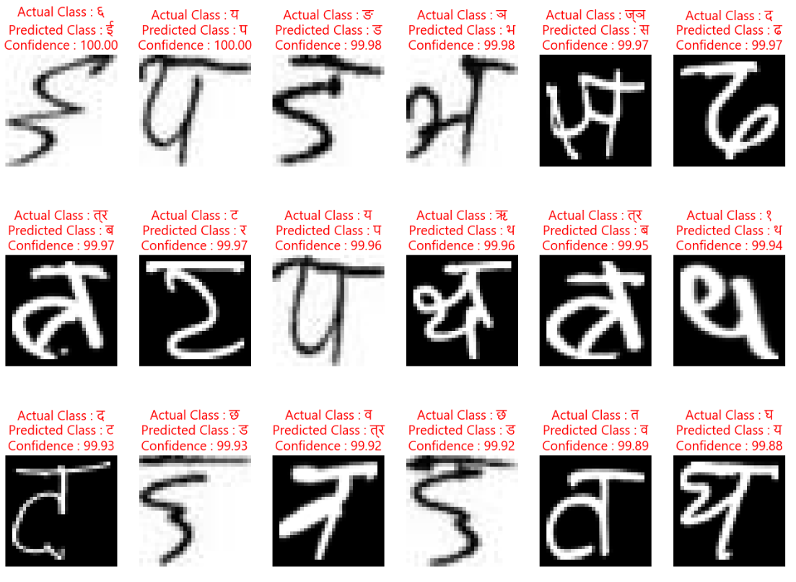
Predictions
Correct Predictions
Incorrect Predictions

Slide 11

Improvement Plans
Accuracy Improvement for Vowels
Coloured Image classification
Include Matra Recognition
Automated merging of different datasets

Slide 12

Future Scope
Text to speech applications
Language translation applications
Shopping & Fast-Tag applications
Digitalization of old Artifacts

Slide 13
Appendix
In order to solve the problem of the vanishing/exploding gradient, this architecture introduced the concept called Residual Blocks. In this network, we use a technique called skip connections. The skip connection connects activations of a layer to further layers by skipping some layers in between. This forms a residual block. Resnets are made by stacking these residual blocks together. The approach behind this network is instead of layers learning the underlying mapping, we allow the network to fit the residual mapping.
VGG16 – It is a CNN architecture proposed by Visual Geometry Group(Karen Simonyan & Andrew Zisserman) at University of Oxford . It is characterized by its depth, consisting of 16 layers, including 13 convolutional layers and 3 fully connected layers.. This is renowned for its simplicity and effectiveness and this architecture achieved top ranks in both (image detection and classification of 1000 categories) at ImageNet Large Scale Visual Recognition Challenge (ILSVRC) annual competition 2014

Slide 14
References
Papers Referred
[1512.03385] Deep Residual Learning for Image Recognition (arxiv.org)
[1409.1556v6] Very Deep Convolutional Networks for Large-Scale Image Recognition (arxiv.org)
Dataset URLs
Devanagari Handwritten Character Dataset - UCI Machine Learning Repository
Devanagari Character Dataset | Kaggle
PPT Template
GIT Repo URL
HindiCharactersRecognition

Slide 15

Thank You

